Slide 1
PMO Implementation Final Report
Prepared By: Hari Thapliyal
Vedavit Project Solutions

Slide 2
Objective of exercise

Slide 3
What is achieved
Pmo setup
Strong new pm
PM culture of different level of planning and tracking
Action focussed
Every project is on management dashboard

Slide 4
What not
Pmo Metrics driven
Kpi driven roles and incentives for PMs

Slide 5
What was done
Trainings
System setup
System customizations
Ensuring people understand the value of process and following the same
Process documentation

Slide 6
Your biggest challenge
Stable and good IT infrastructure for all PMs, PMTs, HoDs
Motivating people that transparency is good.
Till it become org DNA, keep system live by every day followup, check, questions, inspiration
Consistent, unifying, true view of information only from PWA.

Slide 7
Approach

Slide 8
Sample screens of Dashboards

Slide 9
CEO Dashboards

Slide 10
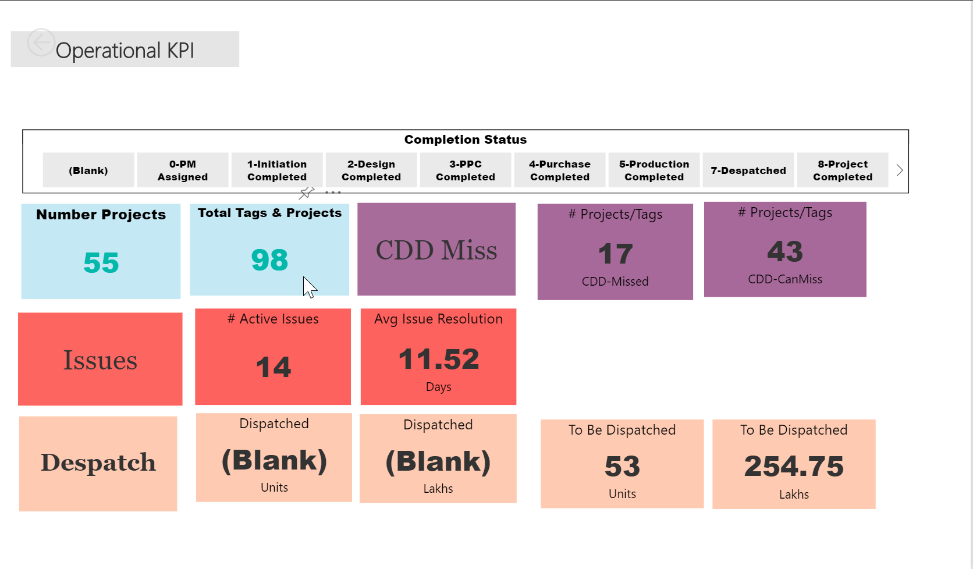
Projects, Issues, Dispatch Summary

Slide 11
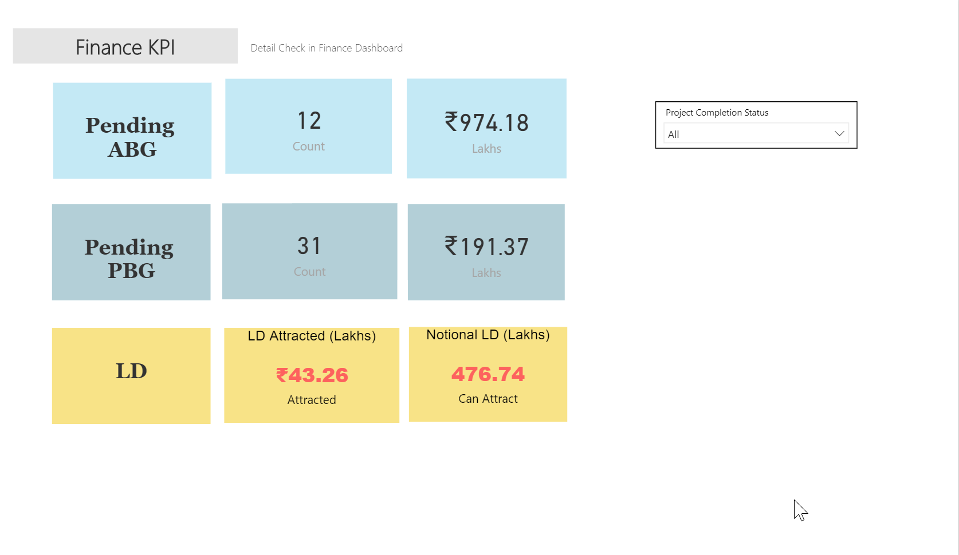
LD, Pending AB, PBG

Slide 12
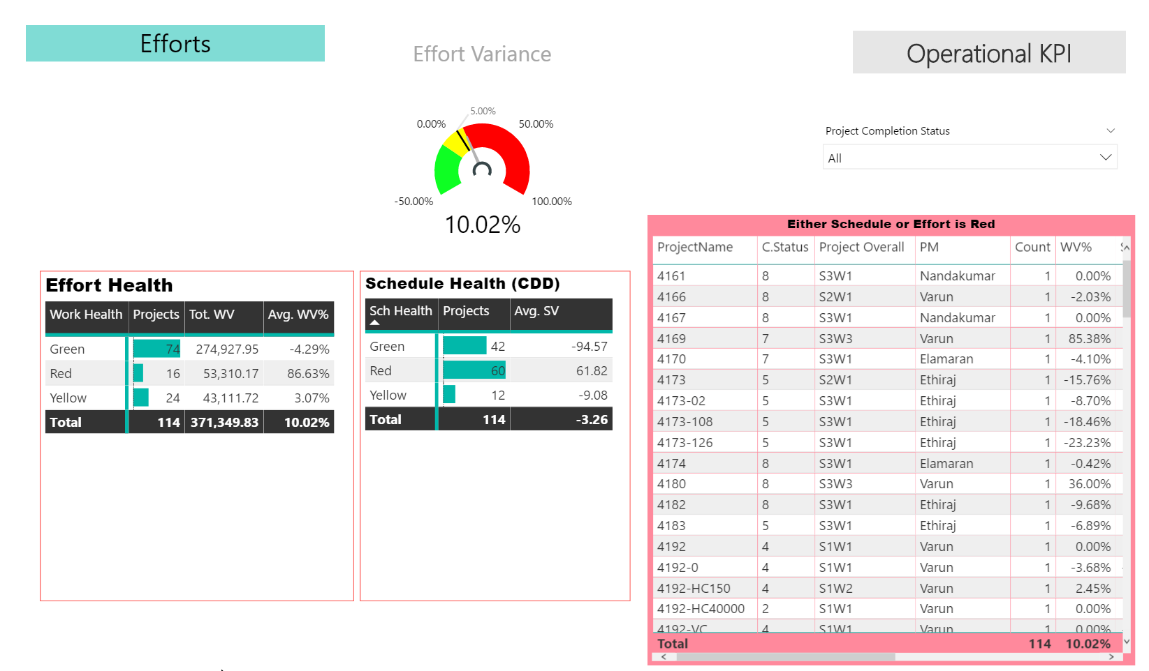
Operational KPI

Slide 13
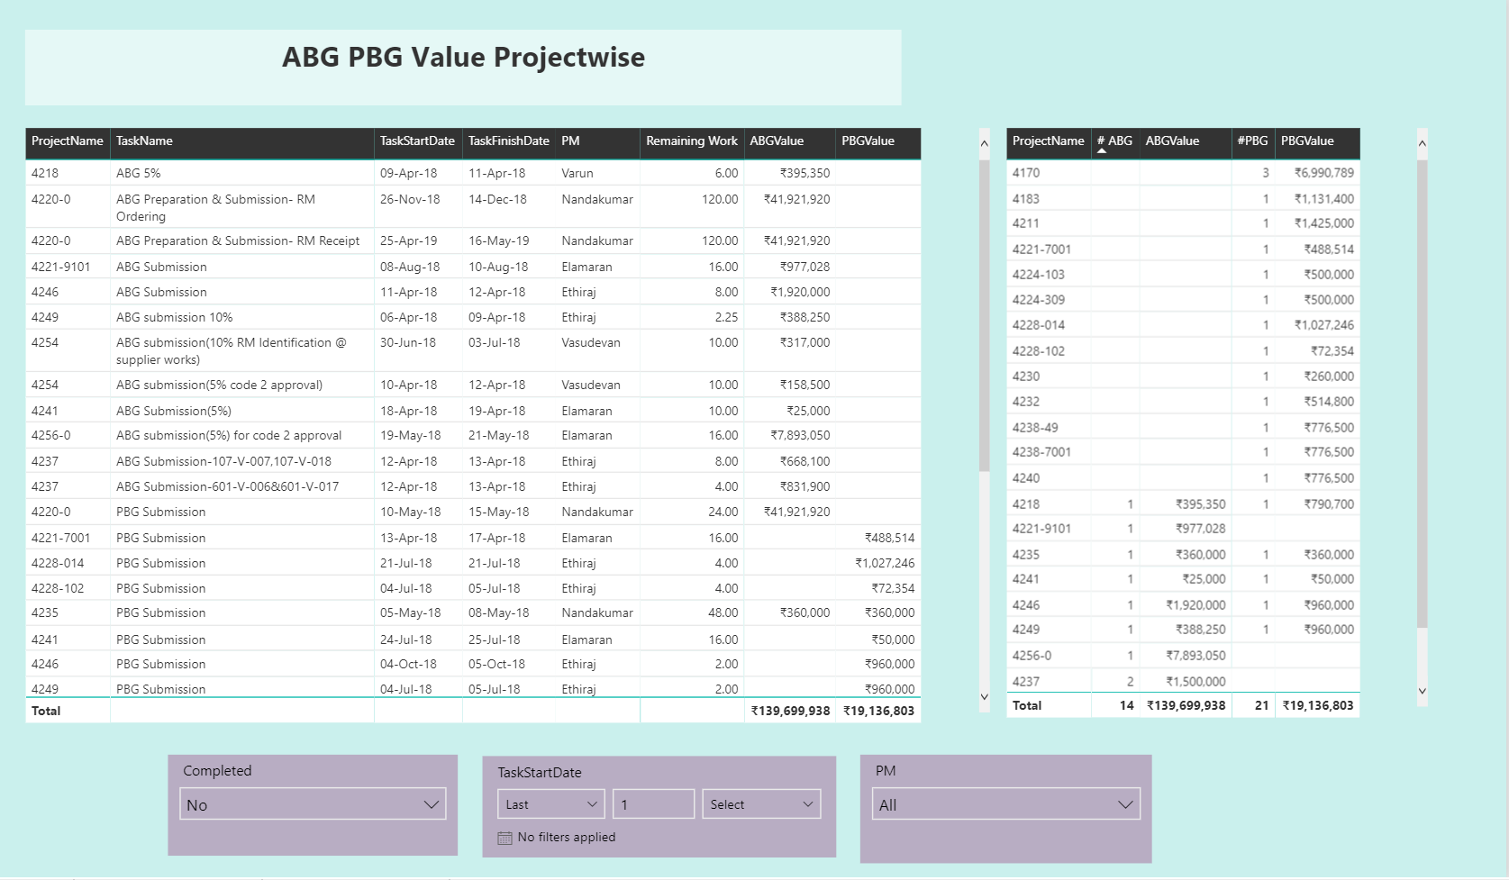
ABG PBG Report

Slide 14
PMO Dashboards

Slide 15
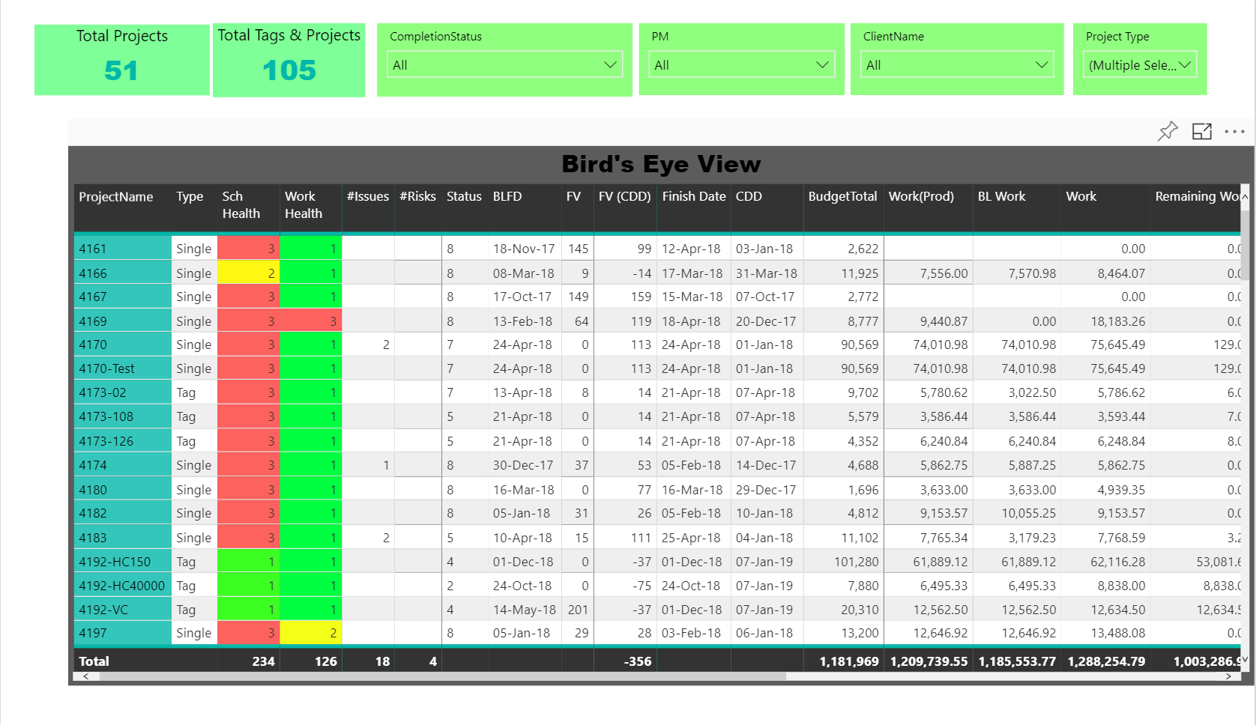
Bird’s Eye View

Slide 16
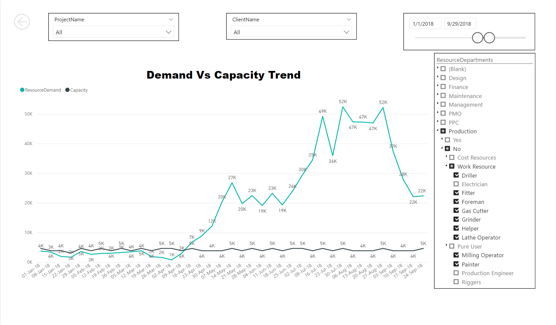
Production Resources (Demand vs Capacity)

Slide 17
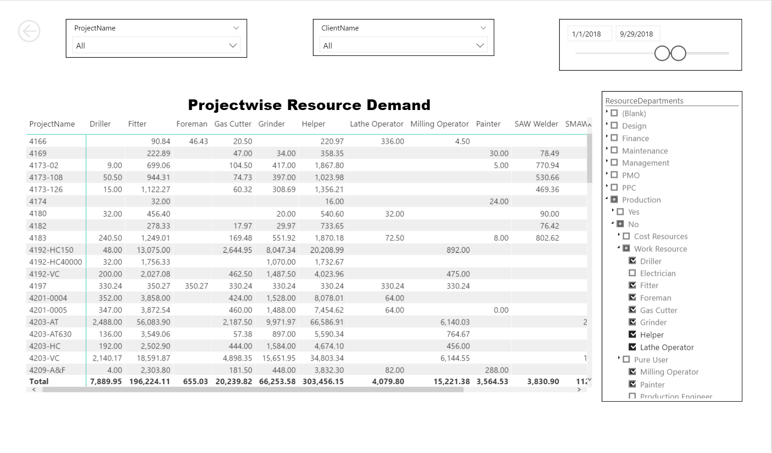
Projectwise Resource Demand

Slide 18
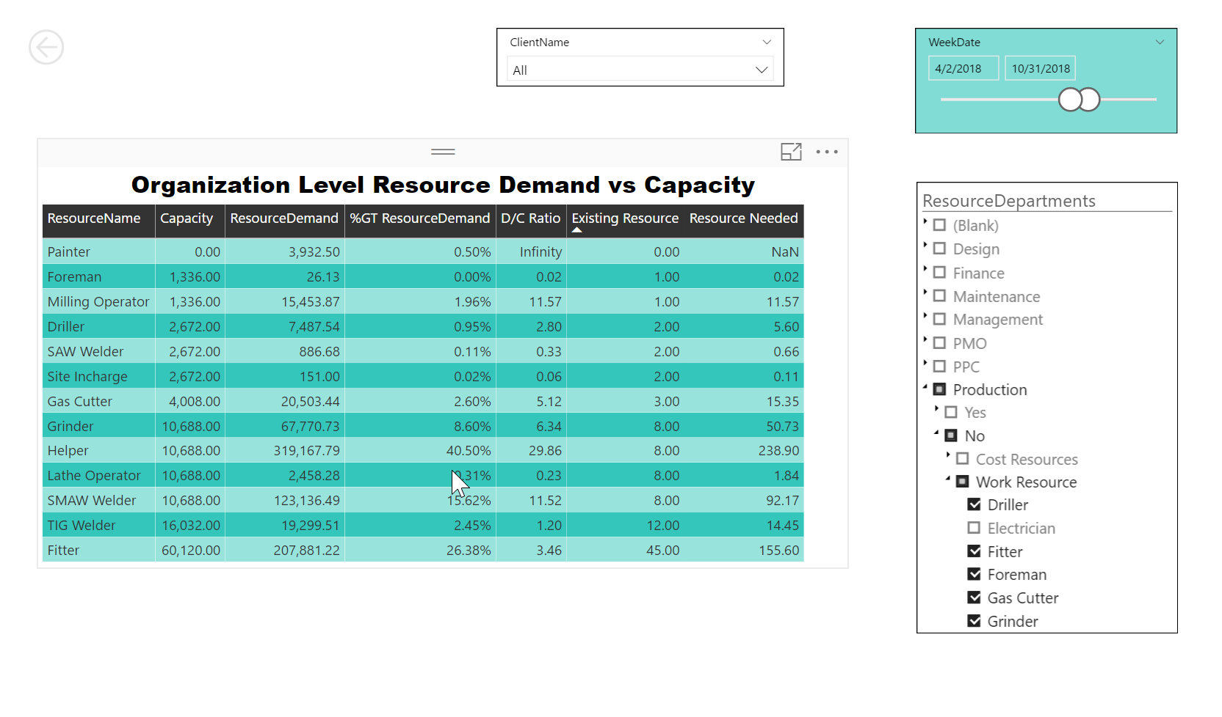
Resource Requirement (# of Resources)

Slide 19
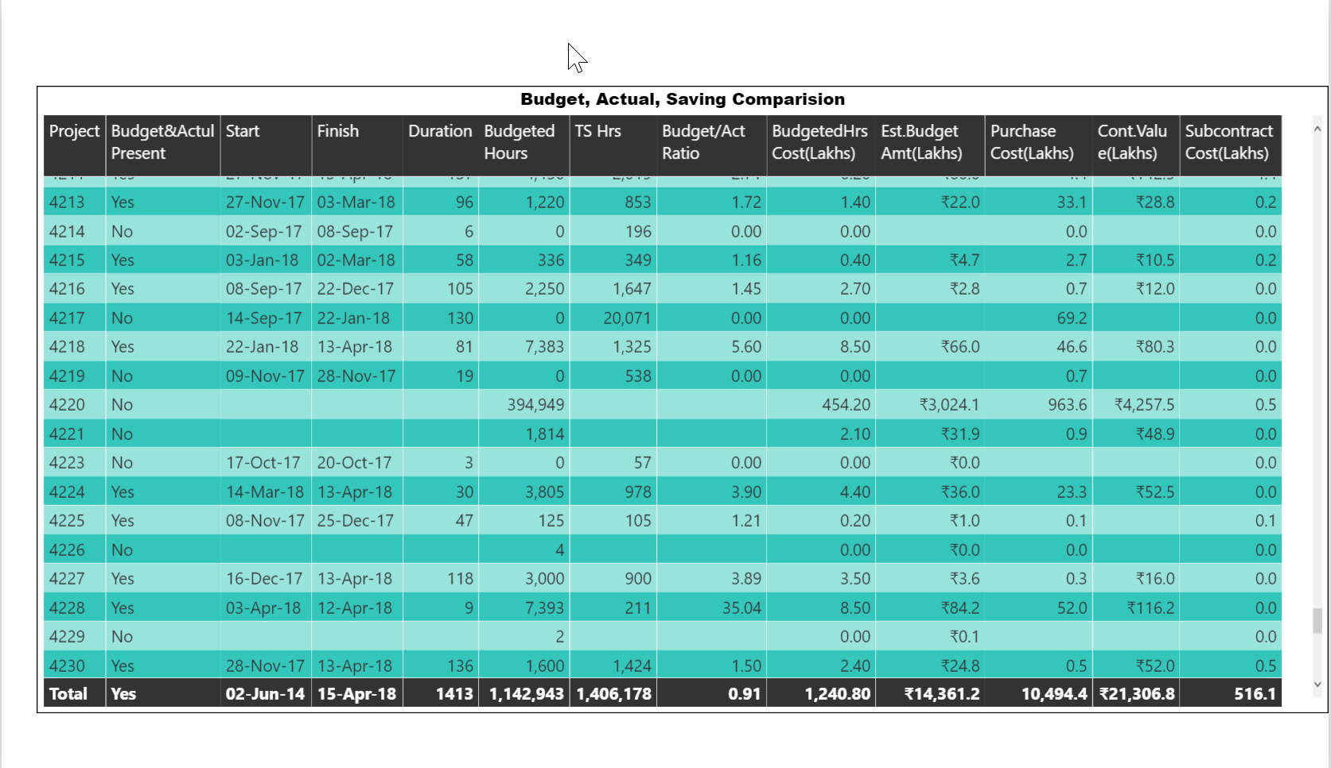
Budget, Actual & Saving Comparision

Slide 20
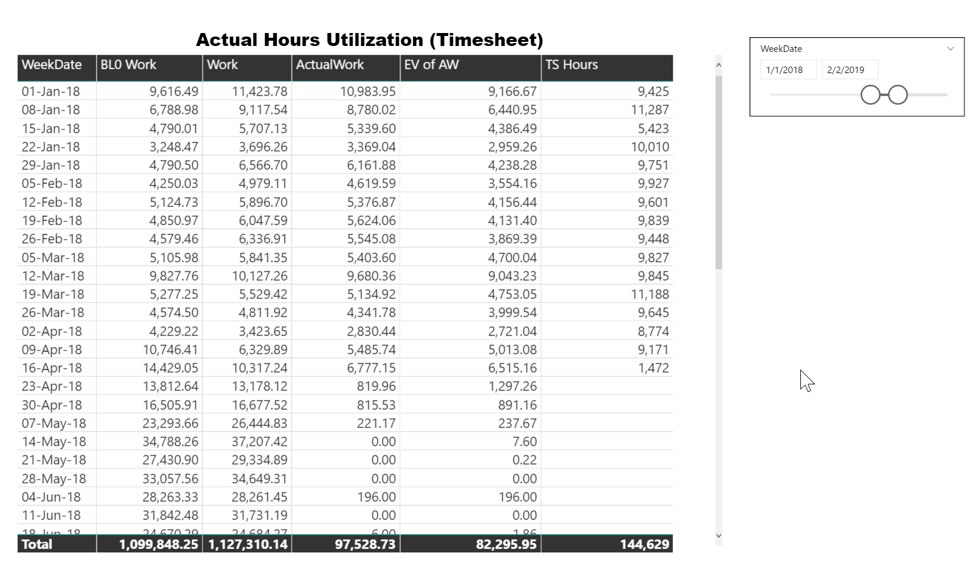
Baseline, Regular, EV, Actual, Timesheet (Work)

Slide 21
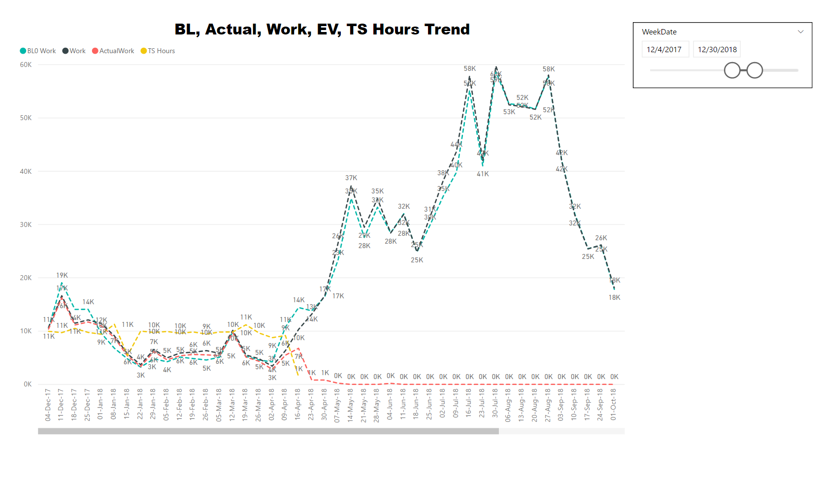
Baseline, Actual, Work, EV, TS Hours Trend

Slide 22
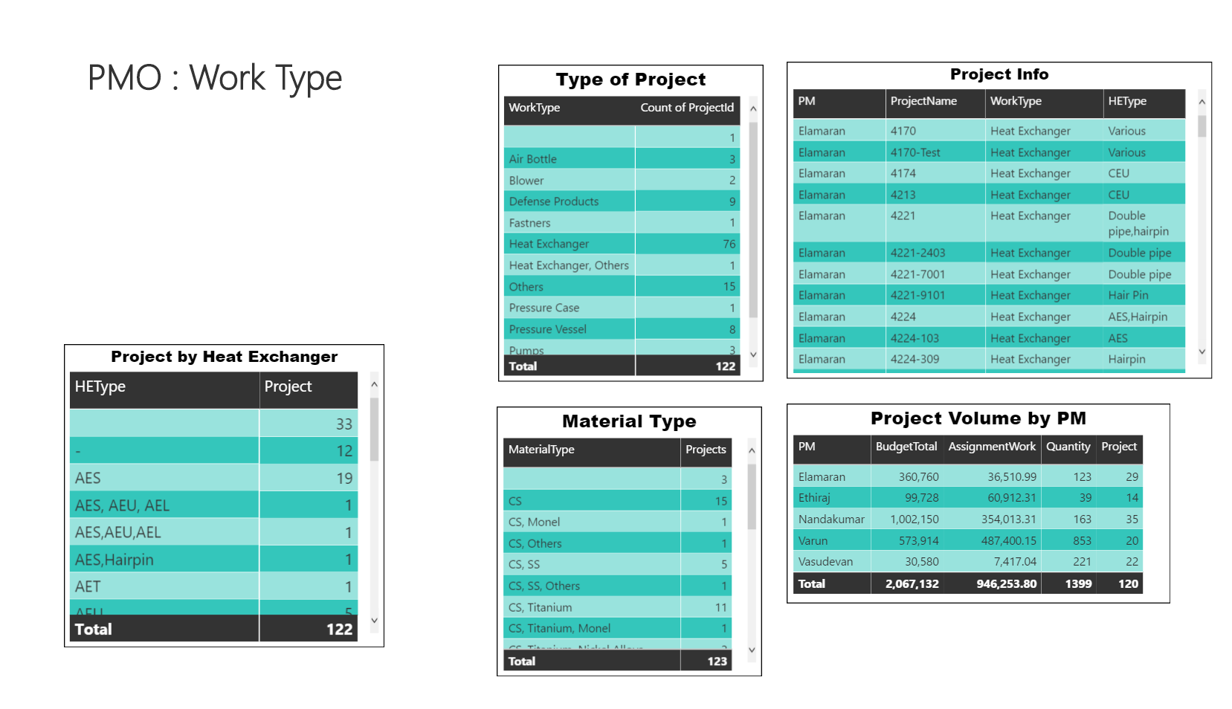
PMO Project Type Analysis

Slide 23
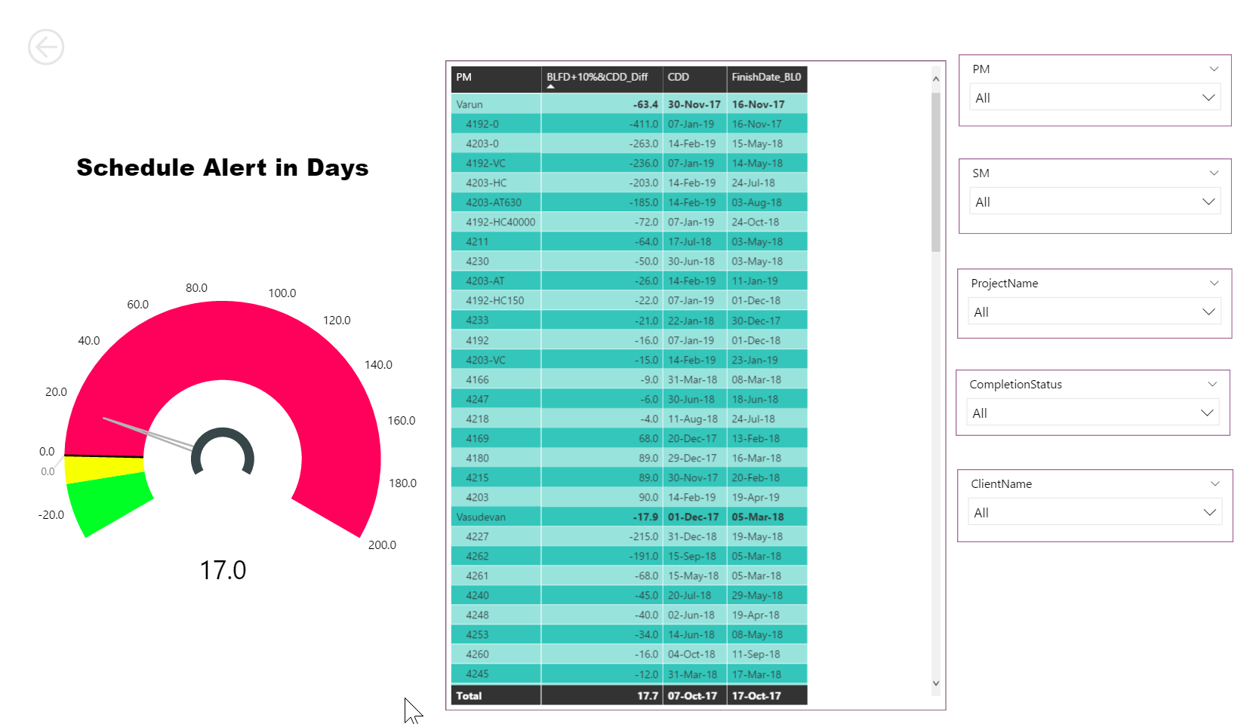
Schedule Alert

Slide 24
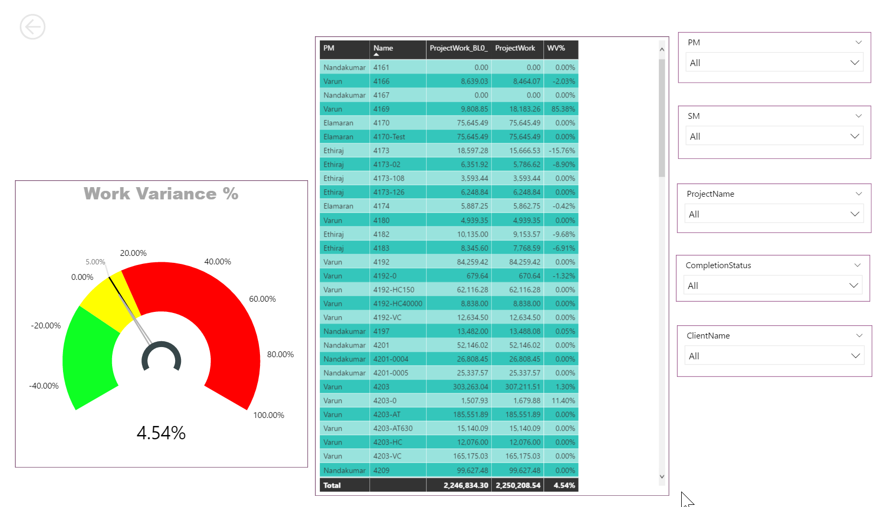
Work Varince

Slide 25
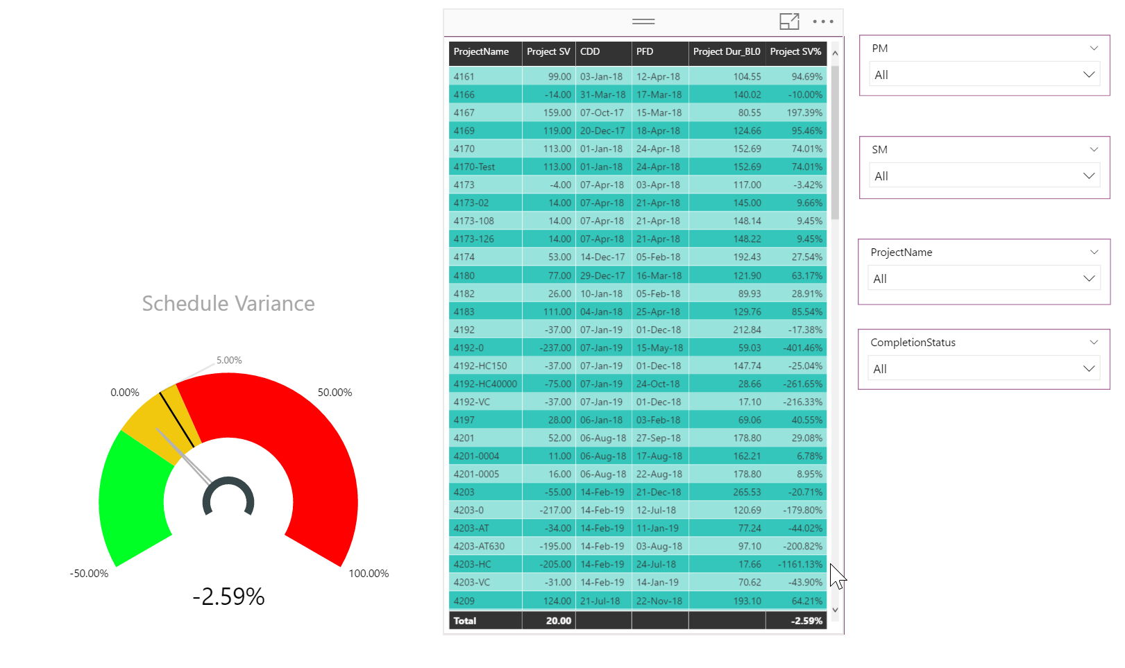
Work Variance

Slide 26
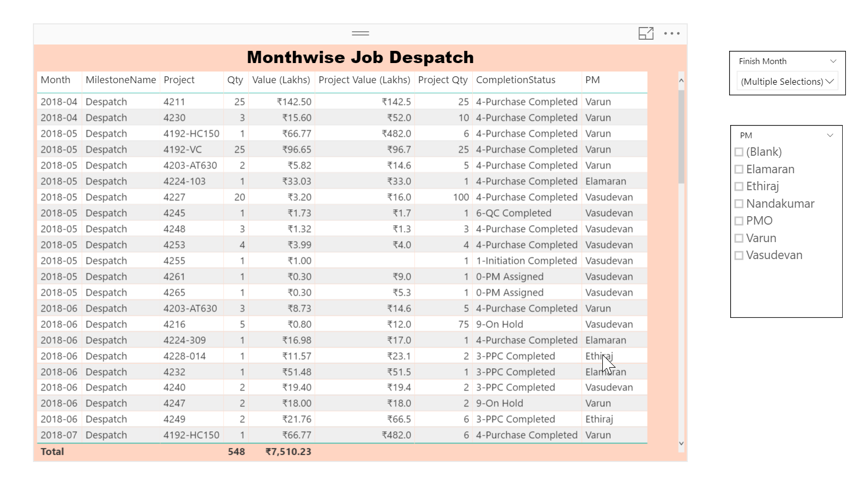

Slide 27
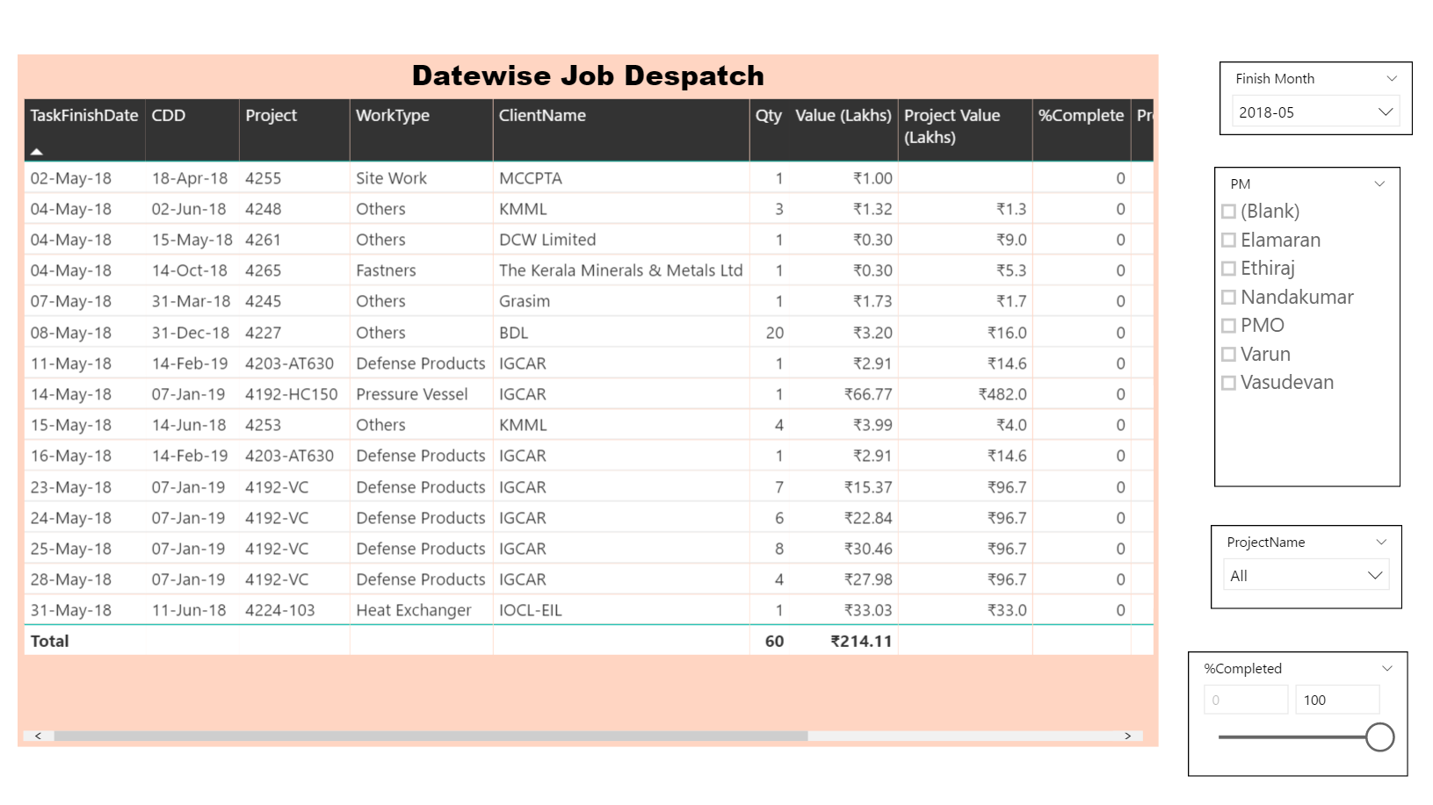

Slide 28
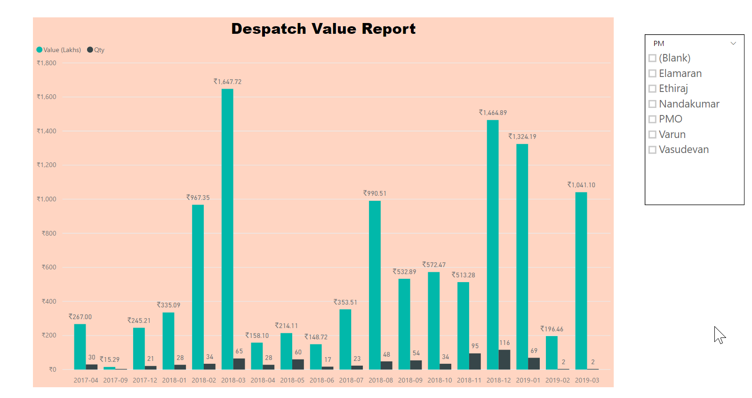
Dispatch Value Report

Slide 29
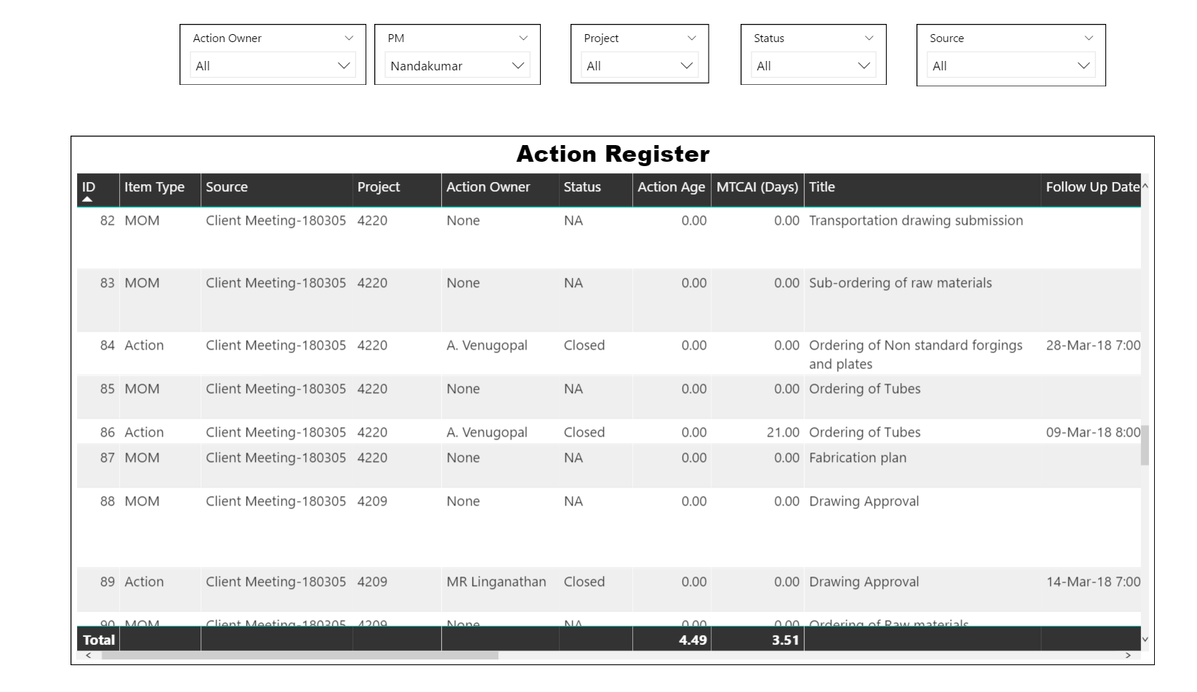
Action Register

Slide 30
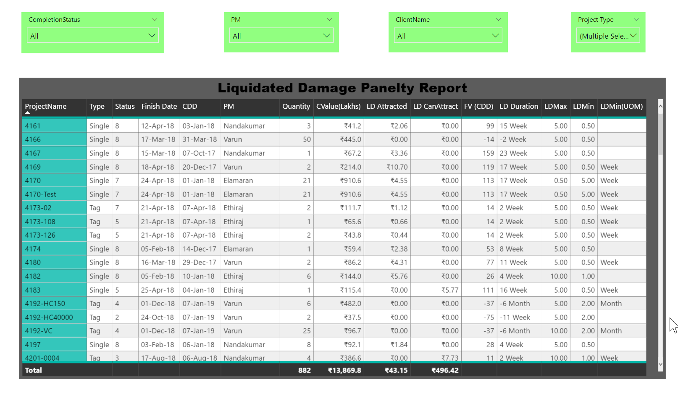
Liquidity Damage Penalty Report

Slide 31
Project Manager Dashboards

Slide 32
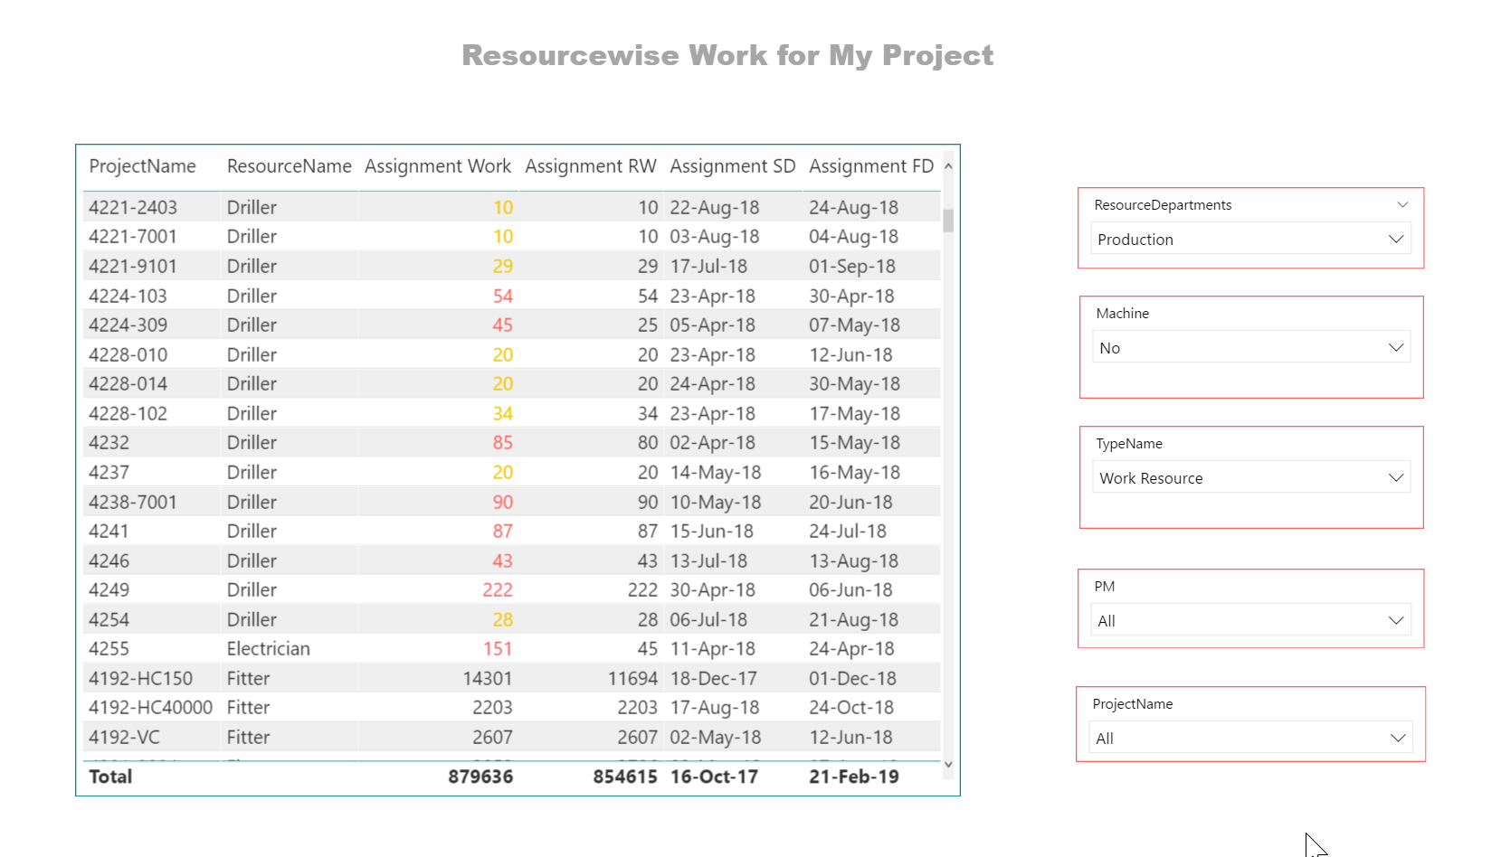
Resourcewise Work on My Project

Slide 33
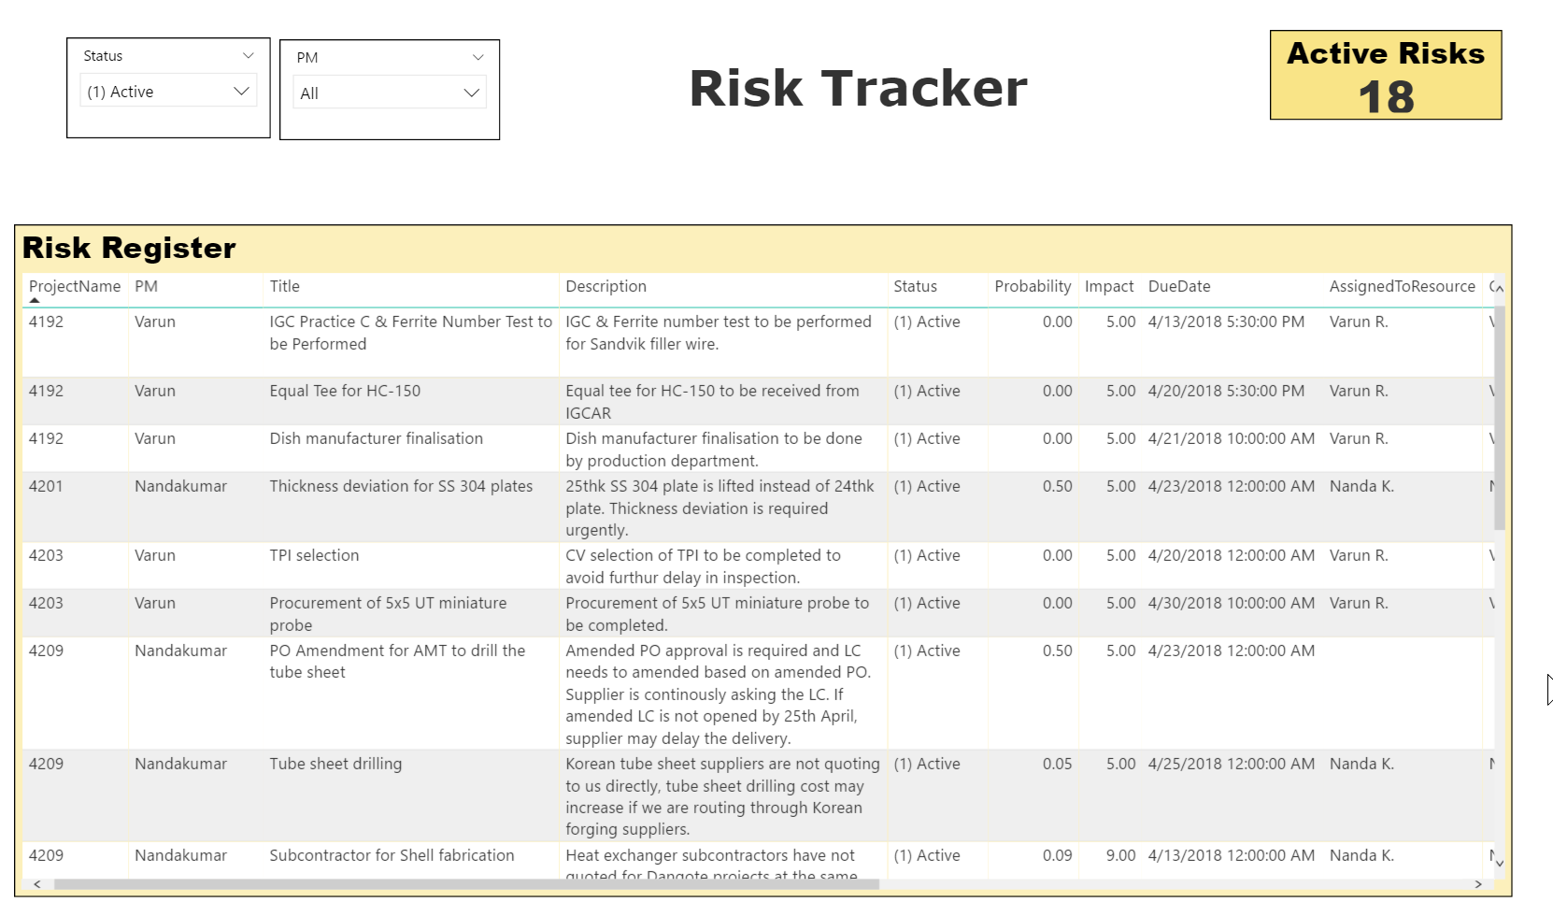
Risk Trackerr

Slide 34
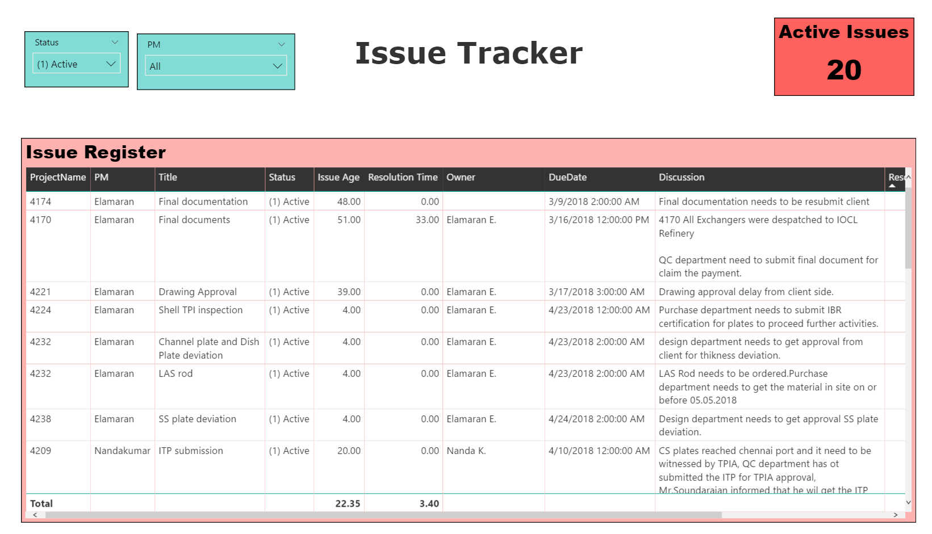
Issue Tracker

Slide 35
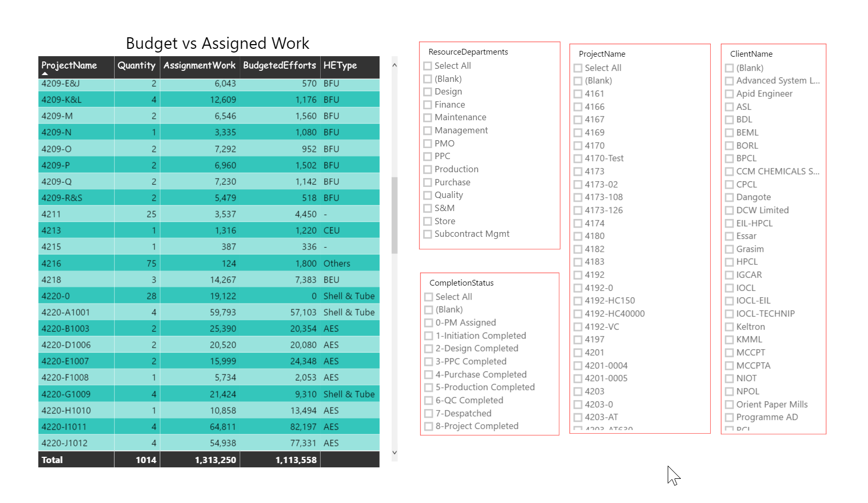
Budget Vs Assigned Work

Slide 36
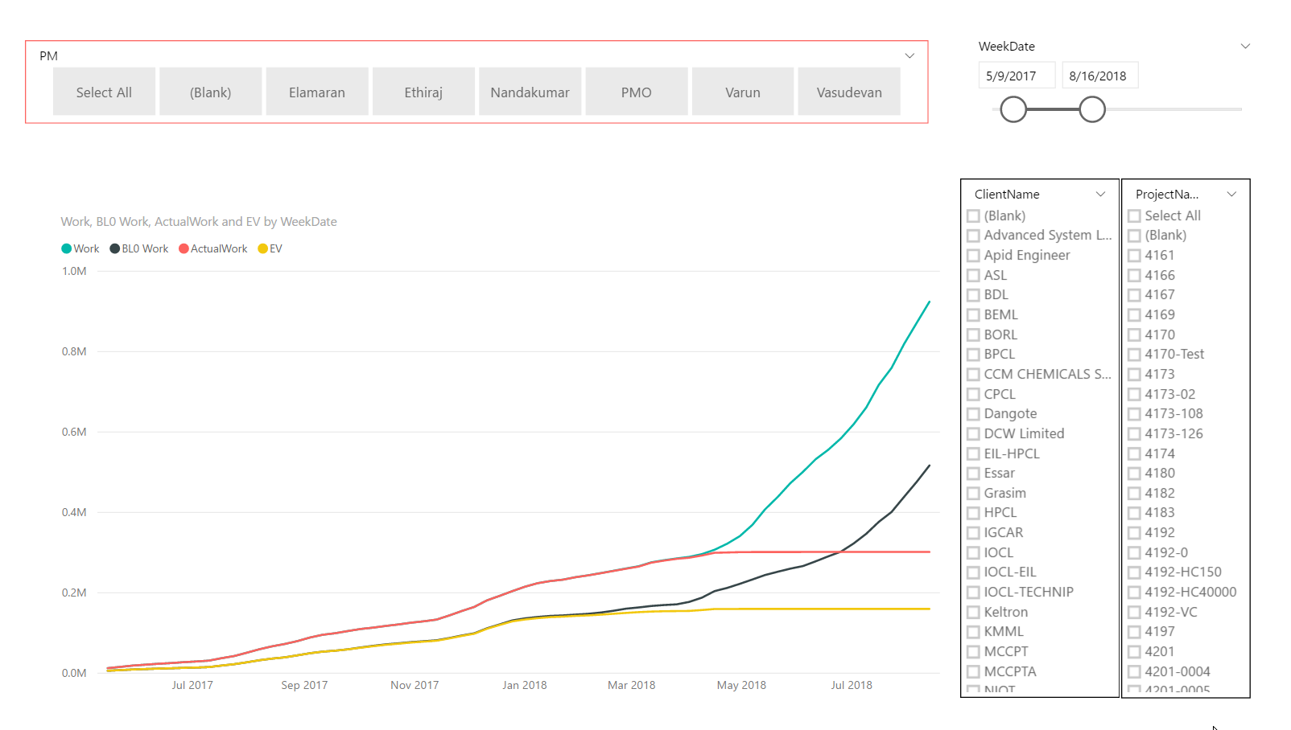
S Curve

Slide 37
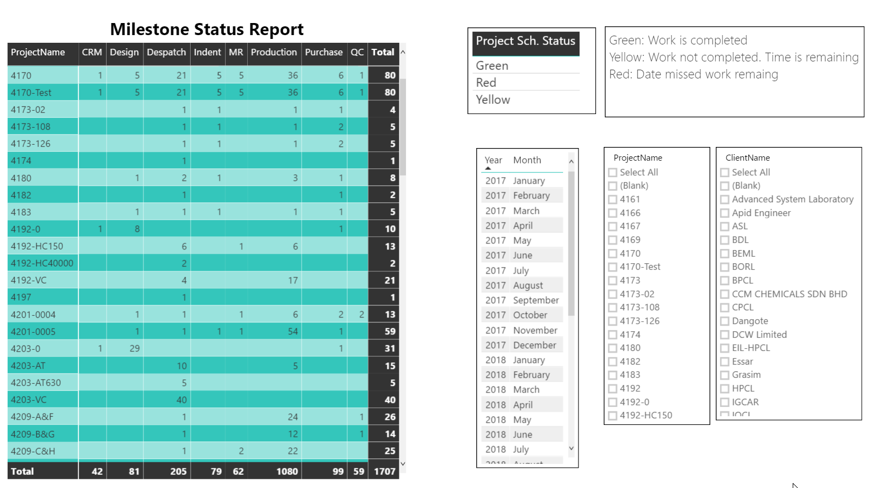
Milestone Report

Slide 38
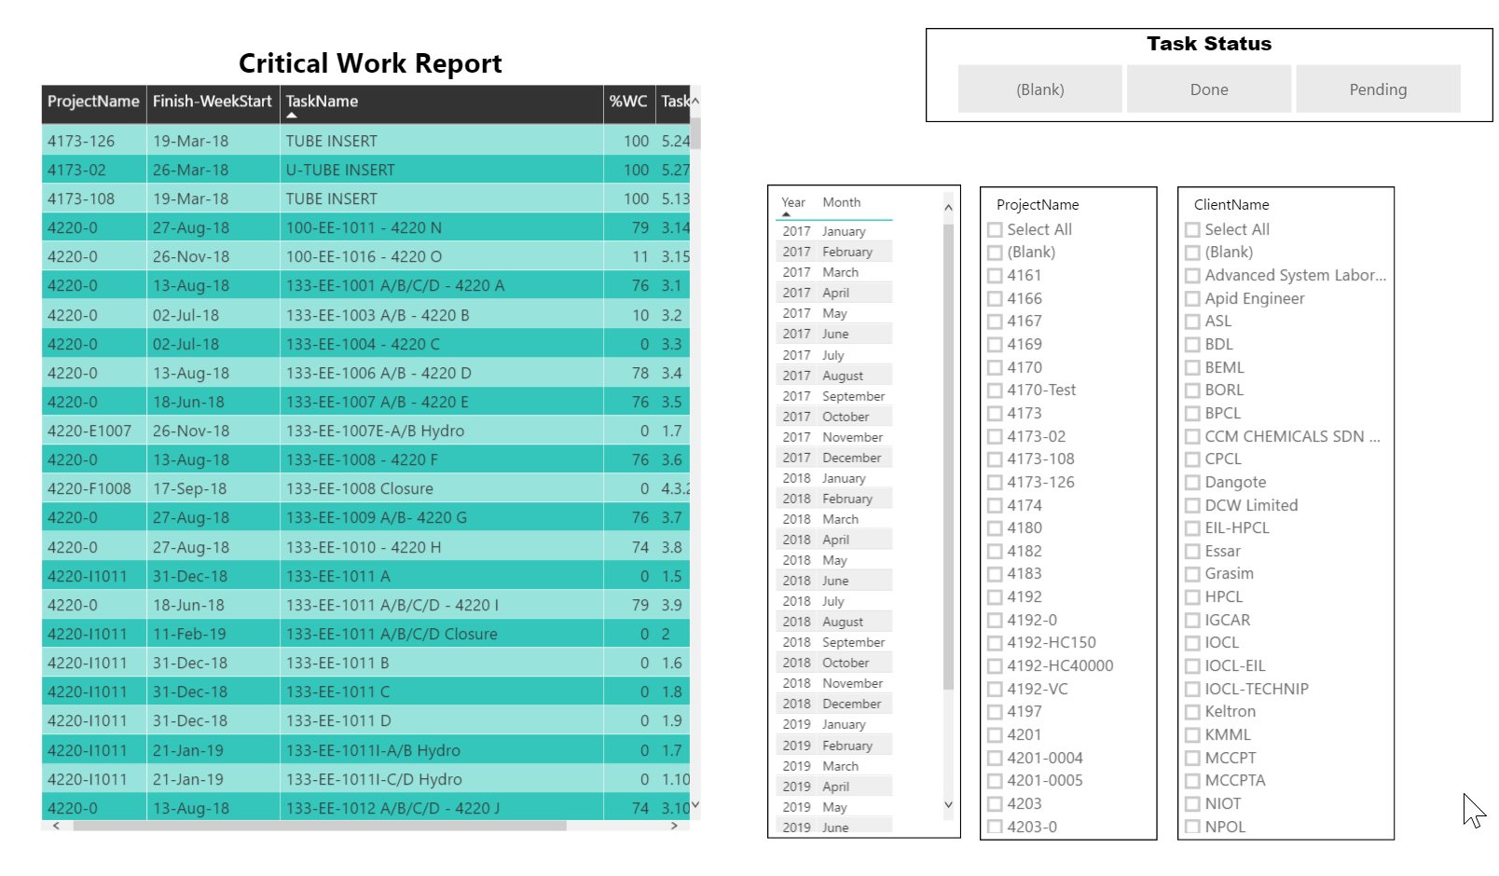
Critical Work

Slide 39
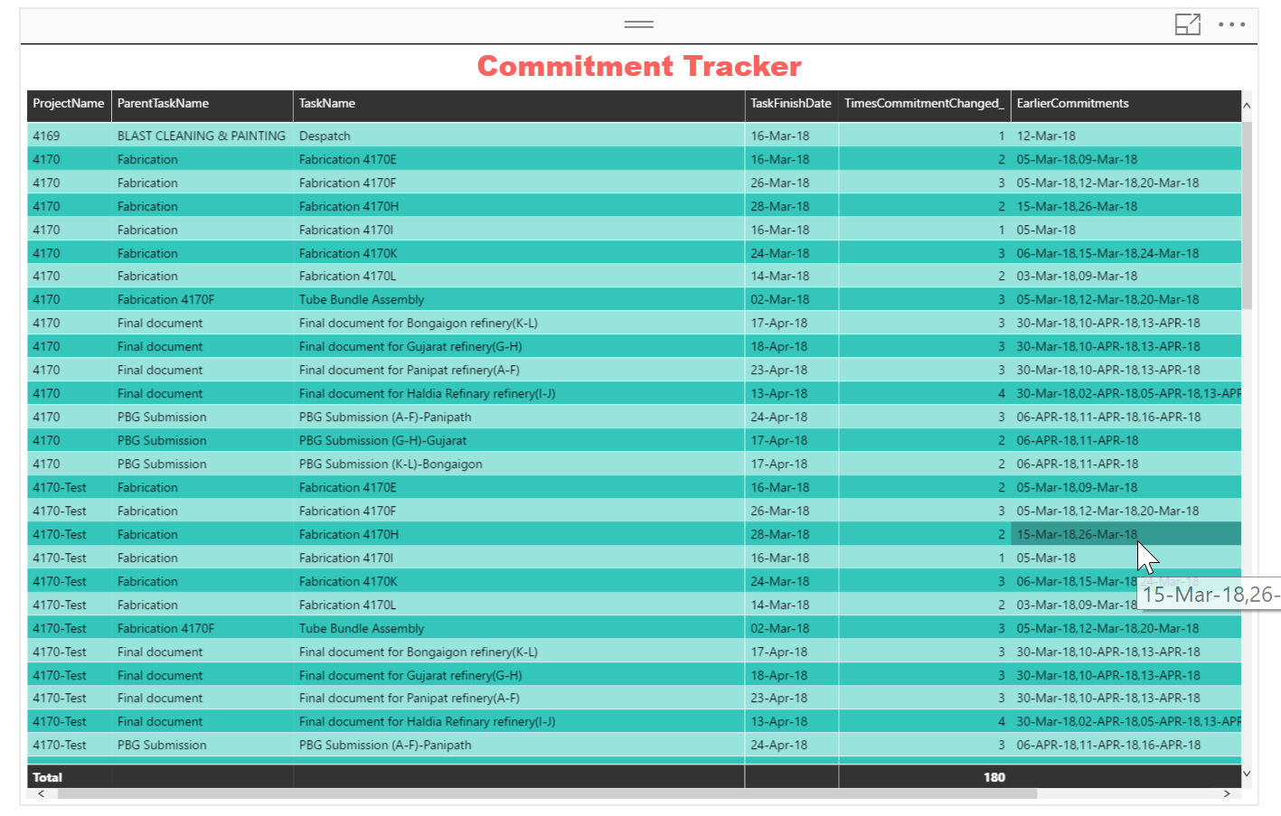
Commitment Tracker

Slide 40
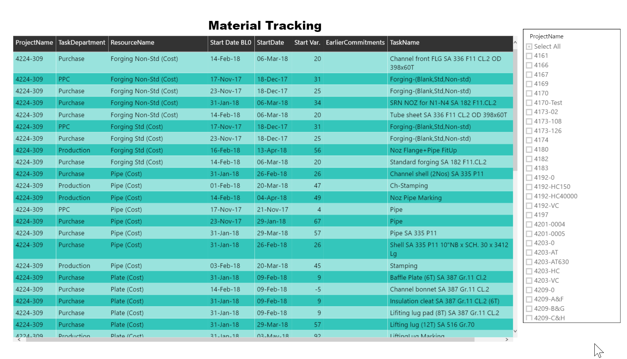
Material Tracking Project Wise (All Material)

Slide 41
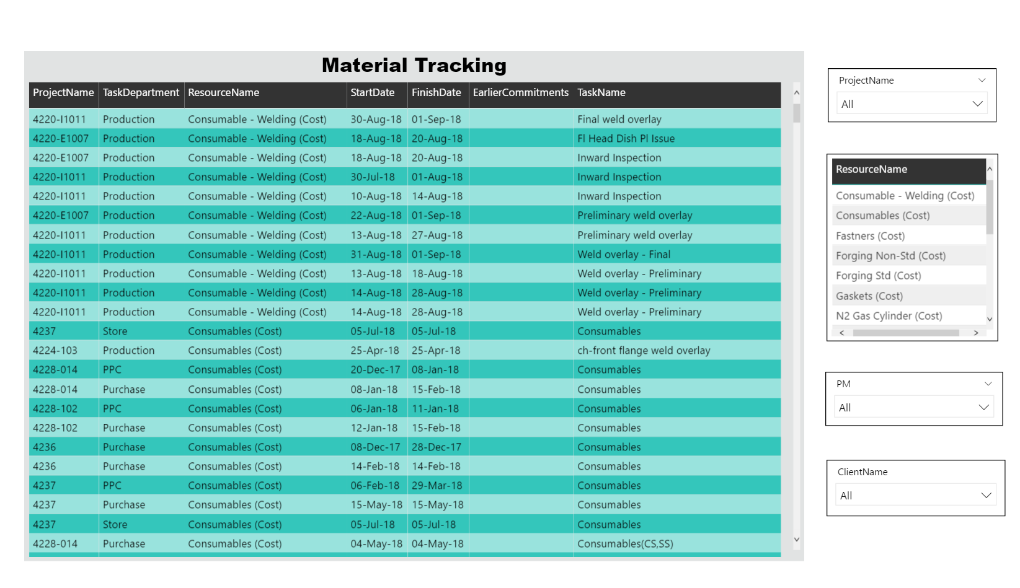
Material Tracking (Material Wise- All Projects)

Slide 42
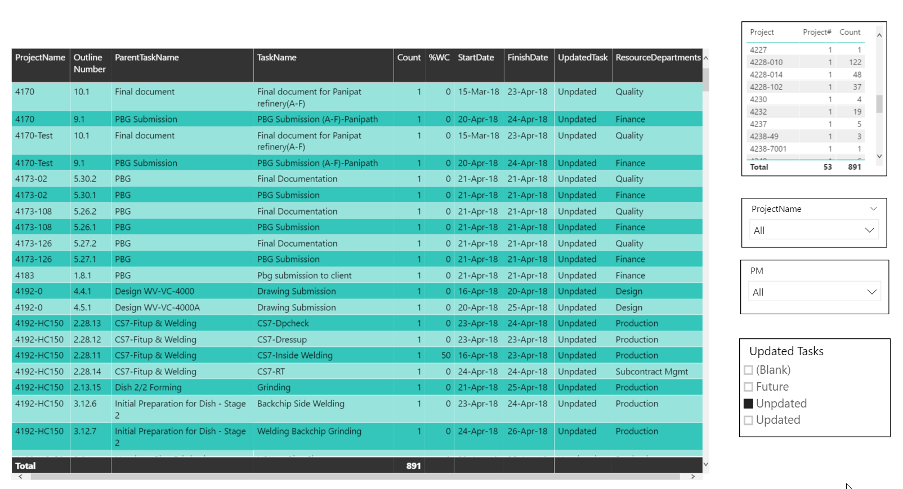
Project Plan Updation Report

Slide 43
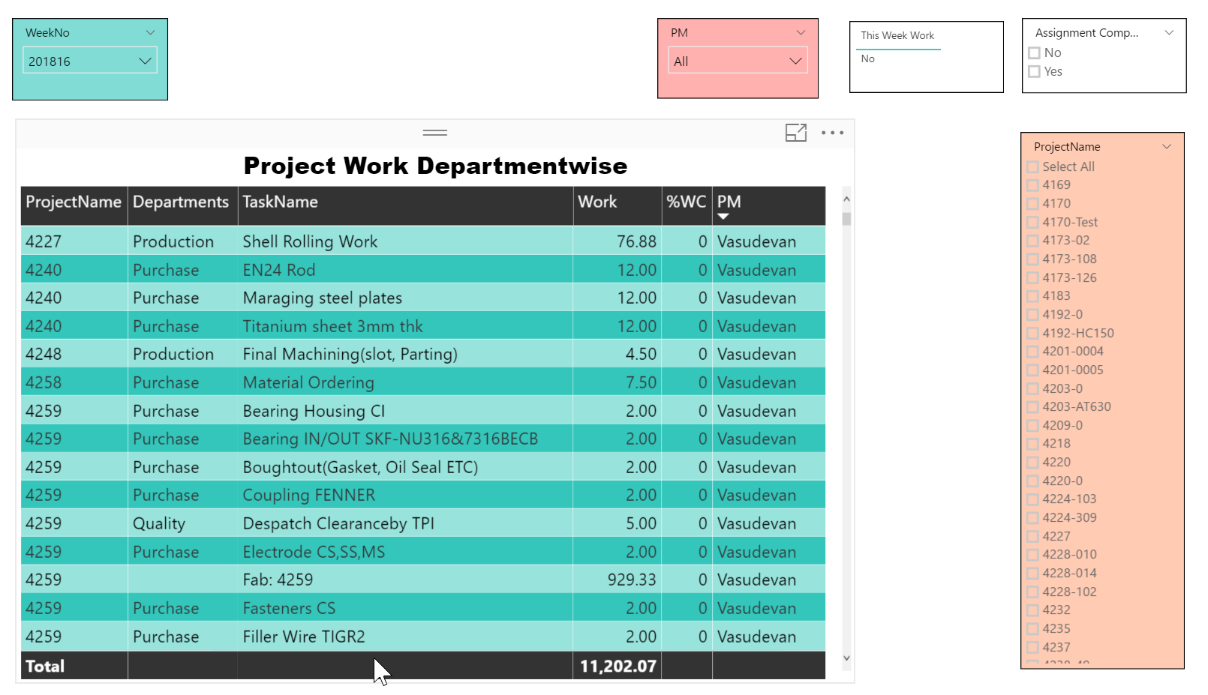
Department-wise Work Weekly Work

Slide 44
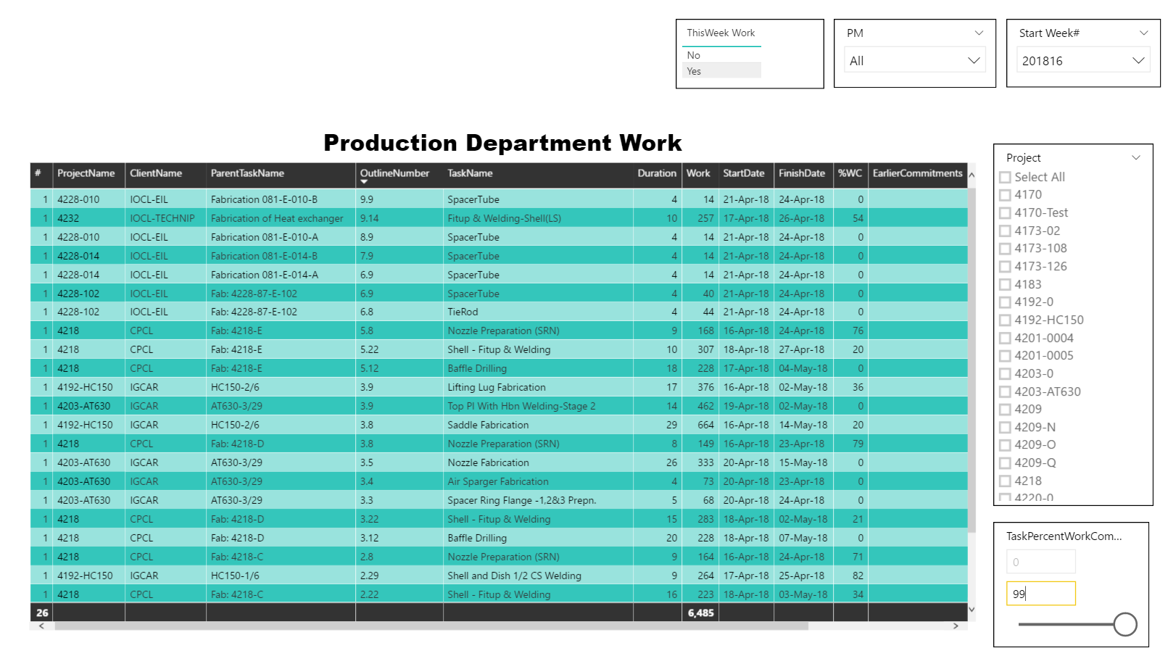
Production Department Weekly Work

Slide 45
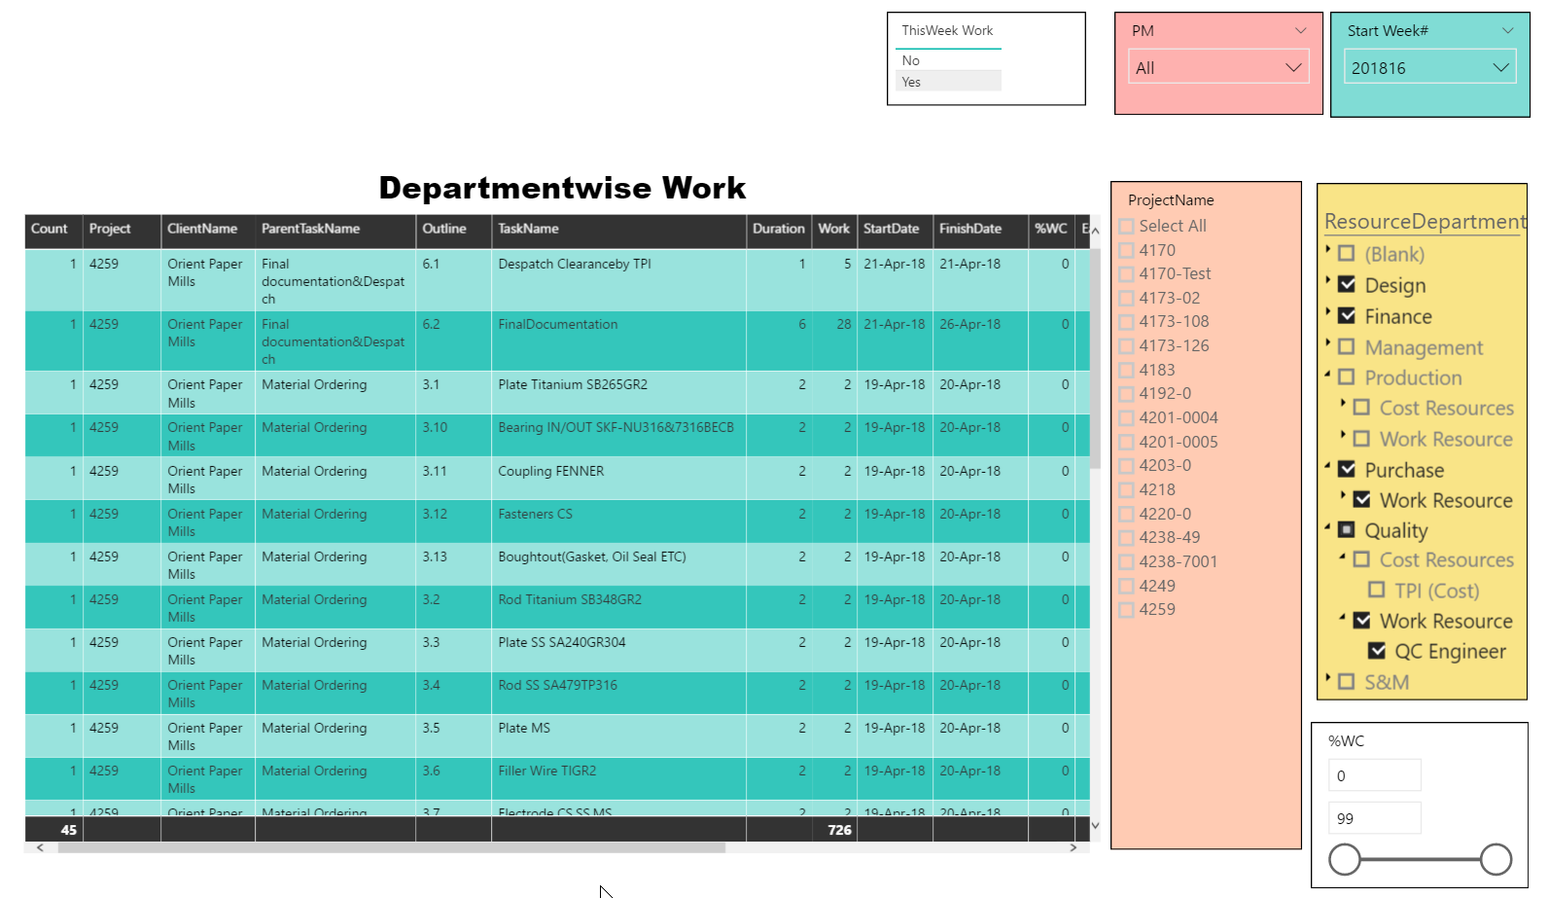
Non Production Weekly Work

Slide 46
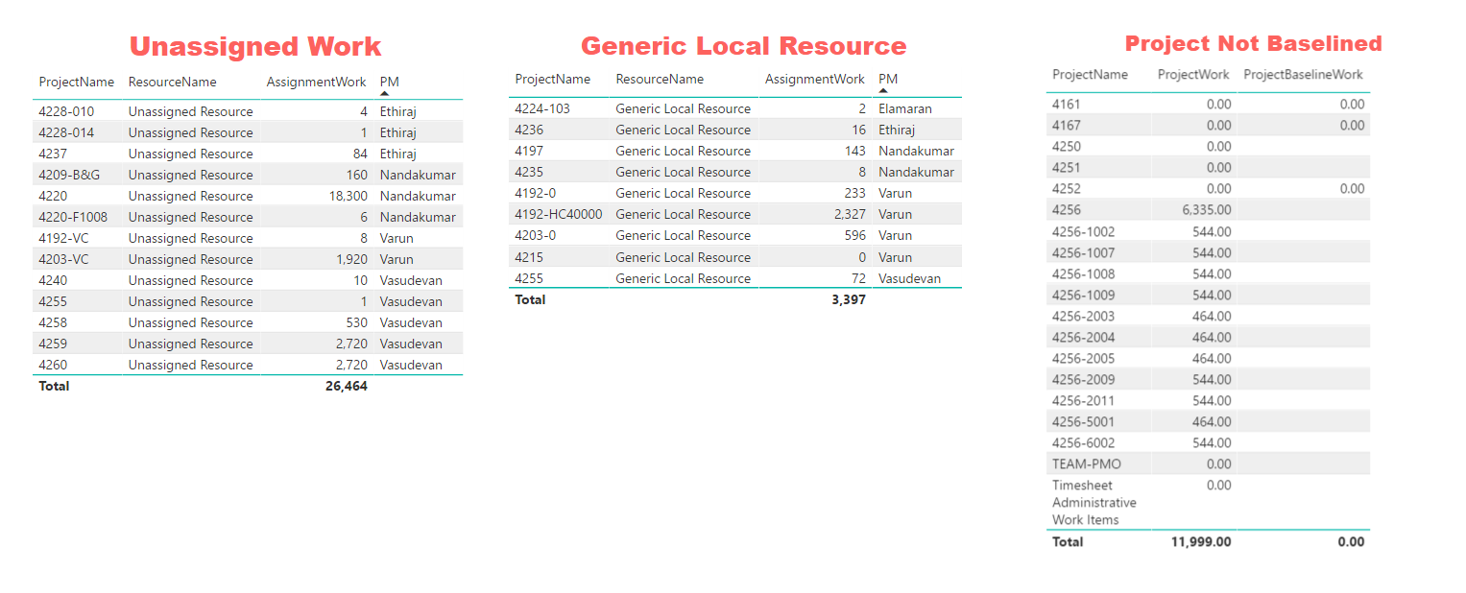
Planning Defect Report

Slide 47
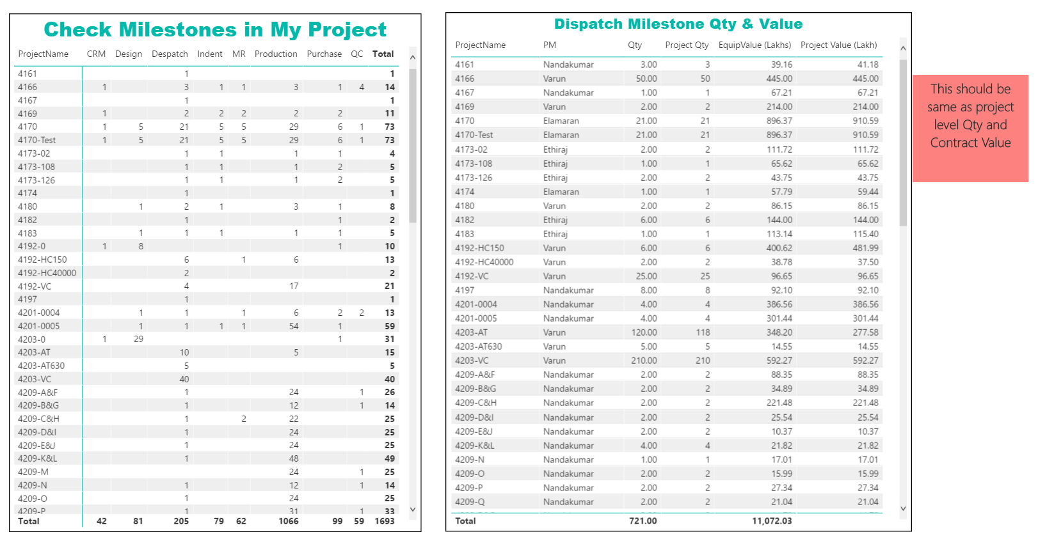
Checking Plan Correctness

Slide 48
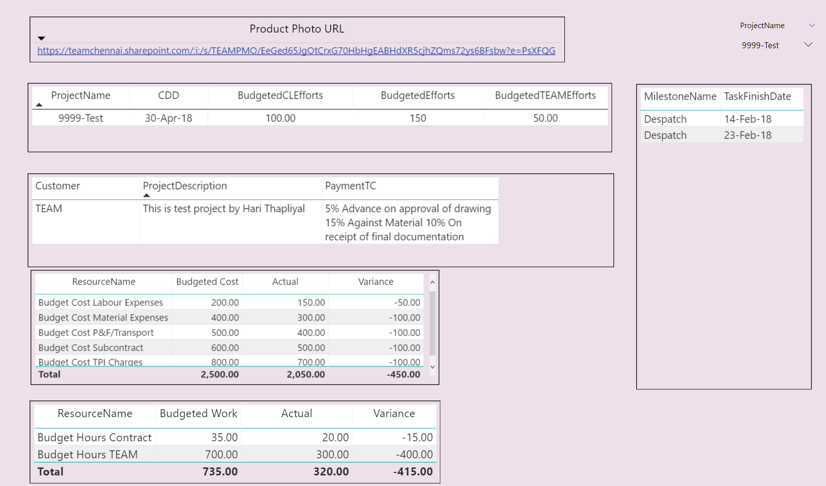
Auto Generated Slide for BRM

Slide 49
PMO SOPs
☒ 01-Kanban Board Updation
☒ 02-Daily Standup Meeting
☒ 03-Weekly Task-Card Printing
☒ 04-Action Register Maintenance
☒ 05-Project Schedule Creation
☒ 06-Project Schedule Updation
☒ 07-Issue Management
☒ 08-Risk Management
☒ 09-MPR (Monday Project Review) Meetings
☒ 10-Project Startup
☒ 11-Project Output Dispatch
☒ 12-Oracle Data Sync In Power BI
☒ 13-Project Creation In PWA
☒ 14-MSP Licensing And Payment To Microsoft
☐ 15-Project Retrospective Meeting
☐ 16-Assigning PM To Project
☒ 17-Project Site Creation
☐ 18-Configuration Management, Backup And Restore
☐ 19-MSP Or PWA Recovery
☐ 20-List of Dashboards And Data Refresh
☐ 21-Project Schedule Review
☐ 22-Tonnage Report Based On BOM
☐ 23-Negotiating Time with Department And Commitment Tracking
☐ 24-Lessons Learn Management
☒ 25-New Configuration In MSP, PWA Or Power BI Dashboard - Out Of Scope

Slide 50
Project Level Customization
# | Field | Department | Entity | Type | Behavior | Formula | Graphical indicators | Lookup Table | Last Updated
1 | Product Photo URL |  | Project | Text | Not required | No | No |  | 12-04-18
2 | Quantity |  | Project | Number | Not required | No | No |  | 01-01-18
3 | Labor Job |  | Project | Text | Not required | No | No | Boolean | 05-01-18
4 | LD (Min %) |  | Project | Number | Required | No | No |  | 07-04-18
5 | LD (Max %) |  | Project | Number | Required | No | No |  | 07-04-18
6 | Budgeted TEAM Efforts |  | Project | Number | Not required | No | No |  | 01-01-18
7 | Delivery Location |  | Project | Text | Not required | No | No |  | 19-04-18
8 | Client Name |  | Project | Text | Not required | No | No |  | 28-12-17
9 | PM |  | Project | Text | Required | No | No | PM List | 21-02-18
10 | WO Date |  | Project | Date | Not required | No | No |  | 12-02-18
11 | Drawing Approval By |  | Project | Text | Not required | No | No |  | 18-04-18
12 | Work Type |  | Project | Text | Not required | No | No | ProductType | 05-01-18
13 | Inspected By |  | Project | Text | Not required | No | No |  | 19-04-18
14 | CDD |  | Project | Date | Required | No | No |  | 09-01-18
15 | Material Type |  | Project | Text | Not required | No | No | Material Type | 05-01-18
16 | Delivery Terms |  | Project | Text | Not required | No | No |  | 19-04-18
17 | Project Departments |  | Project | Text | Not required | No | No | Department | 14-03-18
18 | HE Type |  | Project | Text | Not required | No | No |  | 01-01-18
19 | Completion Status |  | Project | Text | Not required | No | No | Completion Status | 03-01-18
20 | Customer Name |  | Project | Text | Required | No | No | Customers | 19-04-18
21 | LDWeek |  | Project | Number | Not required | No | No |  | 09-04-18
22 | Payment T&C |  | Project | Text | Not required | No | No |  | 12-04-18
23 | LD Min Time UOM |  | Project | Text | Required | No | No | LD Min Time UOM | 07-04-18
24 | Baseline Upto |  | Project | Text | Required | No | No |  | 09-01-18
25 | SM |  | Project | Text | Required | No | No | Sales Managers | 21-02-18

Slide 51
Project Level Customization
26 | Master Plan |  | Project | Flag | Not required | No | No |  | 30-03-18
27 | Budgeted CL Efforts |  | Project | Number | Not required | No | No |  | 01-01-18
28 | Contract Value |  | Project | Number | Not required | No | No |  | 03-01-18
29 | RBS |  | Resource | Text | Not required | No | No | RBS | 29-11-17
30 | Cost Type |  | Resource | Text | Not required | No | No | Cost Type | 29-11-17
31 | Resource Departments |  | Resource | Text | Not required | No | No | Department | 29-11-17
32 | Team Name |  | Resource | Text | Not required | No | No |  | 29-11-17
33 | Machine |  | Resource | Text | Not required | No | No | Boolean | 26-12-17
34 | Qty |  | Task | Number | Not required | No | No |  | 25-01-18
35 | Invoice Date |  | Task | Date | Not required | No | No |  | 12-04-18
36 | ABG Validity Date |  | Task | Date | Not required | No | No |  | 22-03-18
37 | Proposed Date Rejected |  | Task | Flag | Not required | No | No |  | 28-03-18
38 | Proposed Finish Date |  | Task | Date | Not required | No | No |  | 24-03-18
39 | ABG Value |  | Task | Cost | Not required | No | No |  | 12-02-18
40 | Actual Work Against Budget |  | Task | Number | Not required | No | No |  | 12-04-18
41 | % Activity Done |  | Task | Number | Not required | Yes | No |  | 19-04-18
42 | PBG Value |  | Task | Cost | Not required | No | No |  | 12-02-18
43 | Actual Cost Against Budget |  | Task | Cost | Not required | No | No |  | 12-04-18
44 | Flag Status |  | Task | Flag | Not required | No | No |  | 29-11-17
45 | Design Prepared# |  | Task | Number | Not required | No | No |  | 14-02-18
46 | Activity On #Equipment |  | Task | Number | Not required | No | No |  | 12-04-18
47 | Health |  | Task | Text | Not required | No | No | Health | 29-11-17
48 | EarlierCommitments |  | Task | Text | Not required | No | No |  | 23-02-18
49 | Payment Amount |  | Task | Cost | Not required | No | No |  | 12-04-18
50 | Risk |  | Task | Text | Not required | No | No |  | 08-01-18

Slide 52
Project Level Customization
51 | LC End Date |  | Task | Date | Not required | No | No |  | 21-03-18
52 | PBG Validity Date |  | Task | Date | Not required | No | No |  | 22-03-18
53 | Equipment Delivery State |  | Task | Text | Not required | No | No |  | 07-04-18
54 | Design Approved# |  | Task | Number | Not required | No | No |  | 14-02-18
55 | Department Commitment |  | Task | Text | Not required | No | No | Commitment Type | 29-03-18
56 | Invoice # |  | Task | Text | Not required | No | No |  | 12-04-18
57 | Payment Date |  | Task | Date | Not required | No | No |  | 12-04-18
58 | AssignedEV% |  | Task | Number | Not required | No | No |  | 06-03-18
59 | Equipment Value |  | Task | Cost | Not required | No | No |  | 23-03-18
60 | Delay Dueto Proposed Date |  | Task | Duration | Not required | Yes | No |  | 24-03-18
61 | LC Start Date |  | Task | Date | Not required | No | No |  | 21-03-18
62 | MilestoneName |  | Task | Text | Not required | No | No | MilestoneList | 12-02-18
63 | Equipment Delivery Country |  | Task | Text | Not required | No | No |  | 07-04-18
64 | Equipment Delivery City |  | Task | Text | Not required | No | No |  | 07-04-18
65 | Critical Work |  | Task | Flag | Not required | No | No |  | 07-04-18
66 | Task Department |  | Task | Text | Not required | No | No | Department | 26-12-17
67 | RM Location |  | Task | Text | Not required | No | No |  | 02-01-18
68 | Payment Milestone |  | Task | Text | Not required | No | No | Boolean | 02-01-18
69 | Task Location |  | Task | Text | Not required | No | No |  | 02-01-18
70 | Task Vendor |  | Task | Text | Not required | No | No |  | 02-01-18

Slide 53
Lookup Table | Type | Last Updated
Boolean | Text | 26-12-17
Commitment Type | Text | 29-03-18
Completion Status | Text | 20-02-18
Cost Type | Text | 29-11-17
Customers | Text | 23-04-18
Department | Text | 10-01-18
Health | Text | 29-11-17
LD Min Time UOM | Text | 07-04-18
Material Type | Text | 08-01-18
MilestoneList | Text | 13-02-18
PM List | Text | 21-04-18
ProductType | Text | 06-04-18
Project Managers | Text | 21-02-18
RBS | Text | 29-11-17
Sales Managers | Text | 21-02-18

